Slide 1
To Buy or Not to Buy?
That is the question….
This is a copyrighted original work owned by Eugene Bobukh and belonging to his Web site www.bobukh.com.
If you see it anywhere else, it must’ve been stolen. Commercial use without paying out royalties to the author is prohibited.

Slide 2
Disclaimer
This is not a financial advise
You are 100% responsible for any decision you make based on this presentation
I bear no responsibility whatsoever for any conclusions you make based on this work

Slide 3
Disclaimer 2
People optimize different things
We aimed at “what is more profitable under the same financial strain and acceptable risk level?”
For some, it could be “what do I like more?”
For some, “what is the acceptable risk level?”
…or 1000 of other totally legitimate things
I’m not claiming ours is any better than yours
In fact, I’m not even claiming there is no error in my calculations
But if you optimize what we do, you may find it useful
And if not, maybe you’ll find it entertaining, at least

Slide 4
My Stand
House ≠ Investment (see Appendix for detail)
But you still need a place to live. Where?

Slide 5
So, what Could Be Simpler?
A = Expected Profits From Buying
B = Expected Expenses From Buying
C = Expected Rent Cost
If C > (B – A), buy

Slide 6
A, B, C are Made of…
House appreciation rate
Inflation rate
Rent growth rate
Investments appreciation rate
House price
Mortgage interest
And PMI to avoid
House maintenance cost
Closing costs
HOA dues and special assessments
Utilities
Insurance costs
Property taxes!
Investment sale taxes!
Personal tax breaks
Income changes
Career motions
Job changes
Living expenses change
Personal projects
Medical out-of-pocket expenses
Planned education
Costs to support children or relatives
…and a few more
…and they all fluctuate!

Slide 7
Immediate Problem
Nobody has a solid knowledge of those params
Though many claim confidence…

Slide 8
For Starters, Do Houses Really Appreciate?

Slide 9
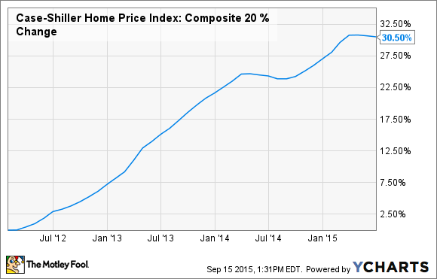
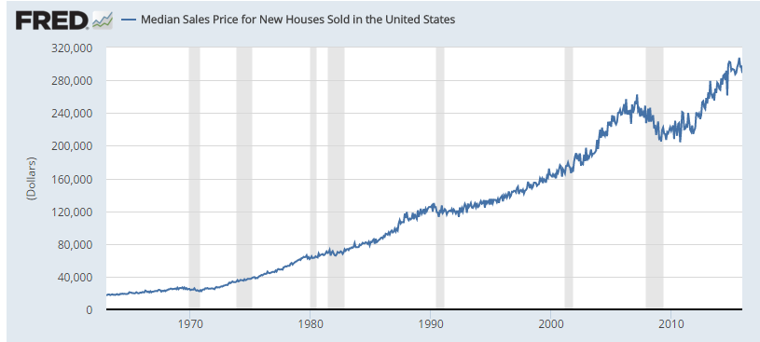
“Yes, Sure!”

Slide 10
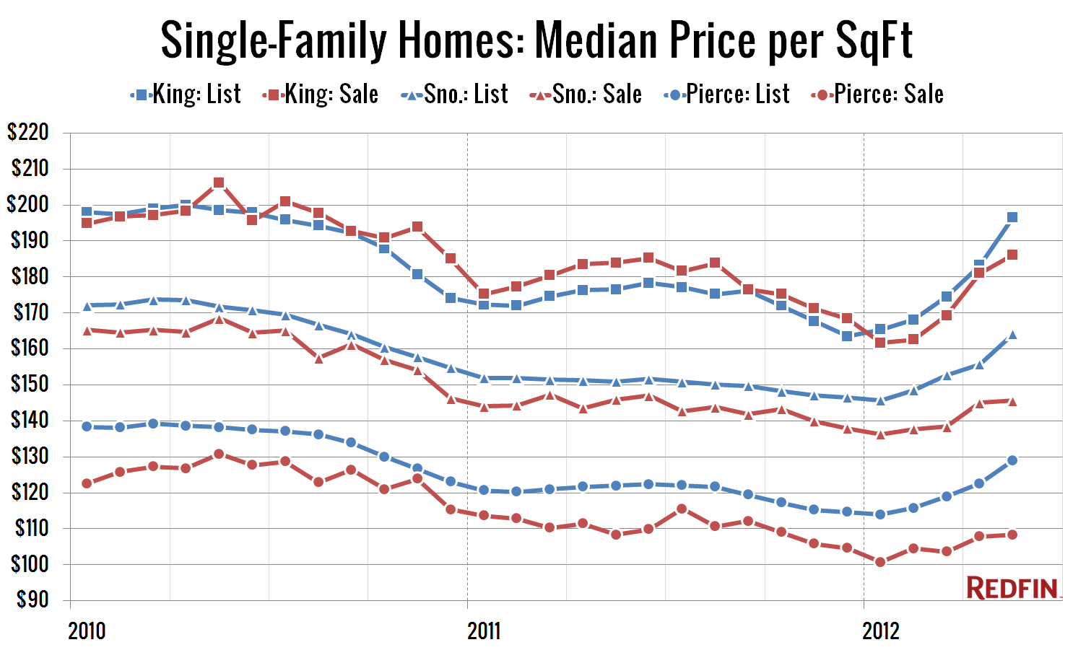
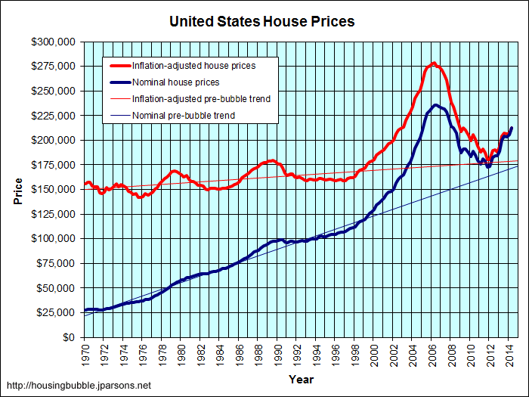
Or Is It More Complex?
Maybe you need to measure by square footage?
And adjust for inflation?
So maybe it, well, fluctuates sometimes?

Slide 11
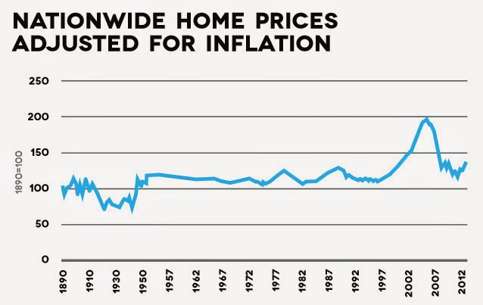
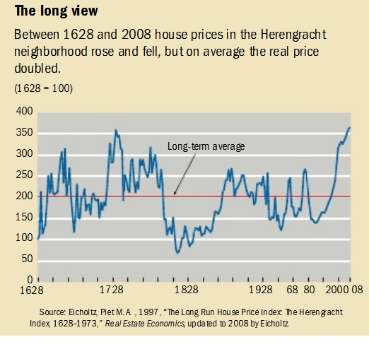
Or Not?
Some research shows that over time periods of 100-300 years, growth rate == inflation rate and all deviations are temporary good/bad luck
This is logical. A house is a collection of {bricks}, why would it appreciate much faster than bricks?
[No. The land on Earth is not scarce – see Appendix for detail]
Notes:
http://kkpropertyinfo.blogspot.com/,
https://hotelivory.wordpress.com/2010/08/29/a-very-long-view-on-house-prices/ -> study of house prices along the Herengracht canal -> http://arno.unimaas.nl/show.cgi?fid=10696 (380 years!)
http://michaelbluejay.com/house/appreciation.html

Slide 12
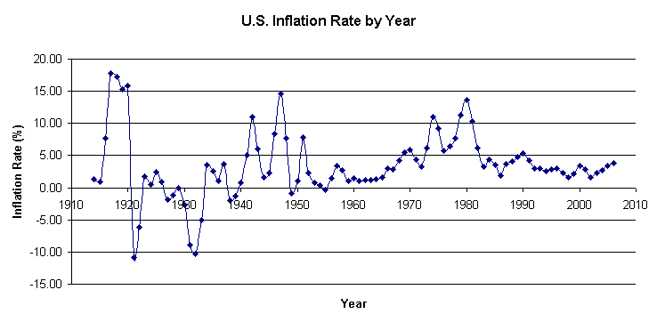
Maybe Inflation is simpler?
http://www.usinflationcalculator.com/inflation/current-inflation-rates/ says it was 2.23% with ±1.15% of variation
Lunch price in my favorite Sichuanese Cuisine (sichuaneserestaurant.com) went from $6 in 2000 to $11 in 2016, that’s 3.8% per year
This http://www.bls.gov/regions/west/news-release/consumerpriceindex_seattle.htm suggests Seattle area had 1.8% inflation in 2011-2016, with stddev of 0.77%?
Wikipedia’s after historic rates over *my* lifetime: 1.5% - 14%
And if you look at healthcare or education, you can easily get 15% (http://www.oftwominds.com/blogaug16/inflation8-16.html)
WTF?

Slide 13
We’ve just considered 2 variables There are 20+ more
???

Slide 14
Common Approach
Make couple assumptions
E.g., “homes will appreciate”
Ignore the rest of the world
Hold dear for that and push!
This, actually, works more often than you would expect, for reasons that go too far into the “regularization” realm of the math

Slide 15
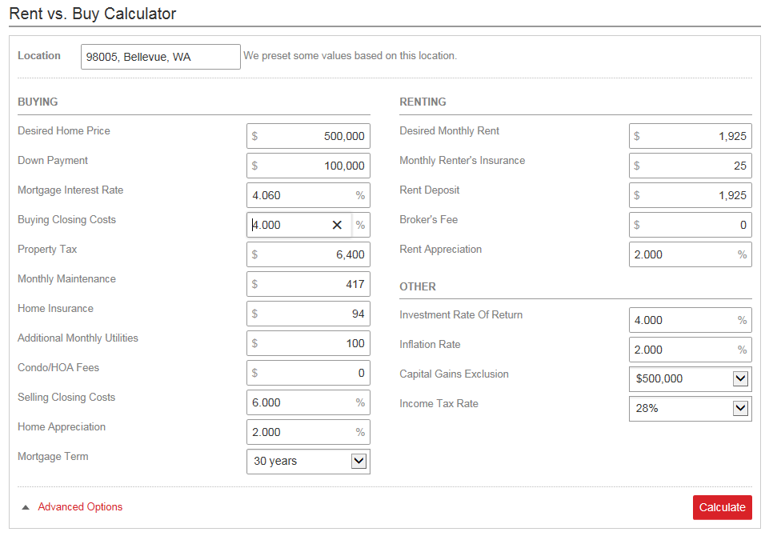
Problems with the traditional approach?
Parameter values are random guesses
Thus it measures one’s optimism rather than predicts the future
Depending on the assumptions, can produce anything from -∞ to a dodecahedra elephant
The primary risk source is not market uncertainty but my own ignorance about it

Slide 16
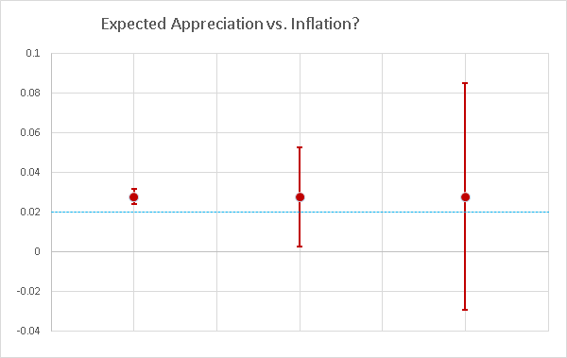
How Much Don’t I Know?
The uncertainty of situational awareness defines different game types:
A sure bet
A calculation
A gamble

Slide 17
Estimate the Uncertainty of my Own Knowledge
Don’t try to be perfect about external parameters
You won’t get precisely most of them
Focus on measuring the uncertainty of your own knowledge
Измерить степень своего незнания

Slide 18
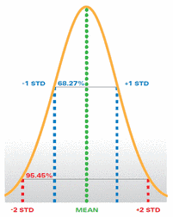
Approach, 1/2
Look at each of those 20+ variables
Get historical records, analytics, personal experiences
See how much they disagree
Define the “best guess” and the uncertainty range for each (and distribution type, yes)
Create N = 10,000 virtual “worlds”
In each world, treat each parameter as a random variable
In 2017, inflation would be 2.7%
In 2018, it would be 1.9%
In 2019, it would be 3.6%
…

Slide 19
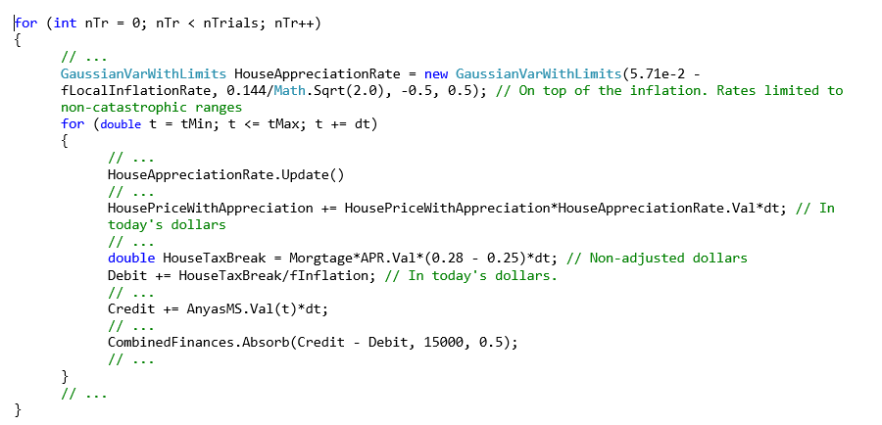
Approach, 2/2
Compute cash flow to T years from now
Push virtual “self” into each world
How would I respond (e.g., by saving/spending/investing) under different financial pressures?
Compute the probability of
…insolvency
…loosing money
…getting a profit
…getting a deal better than renting

Slide 20
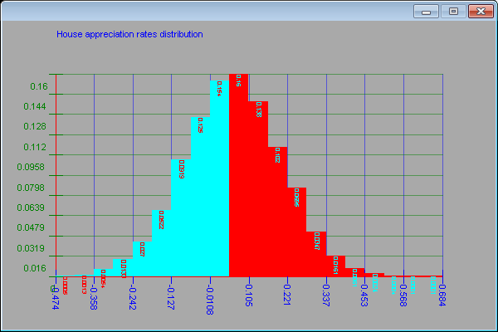
E.g.: House Appreciation Rate

Slide 21
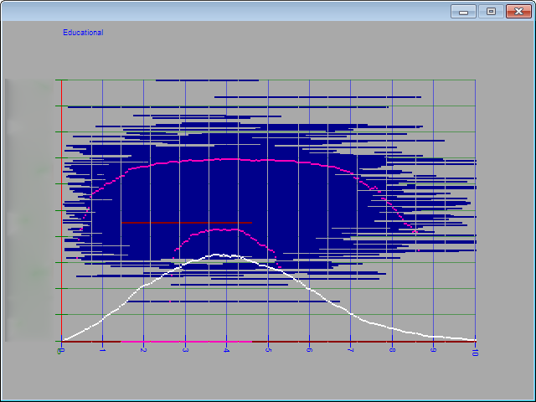
E.g.: education expenses vs time
Blue are individual outcomes in each of the “worlds”
White is the average
Pink is top 95%, median, and bottom 5%
Notes:
Blue are actual realizations, dark red is one of them randomly chosen (for debugging), top pink curve is the upper 95%, middle pink is median, bottom pink is lower 5%, white is average.

Slide 22
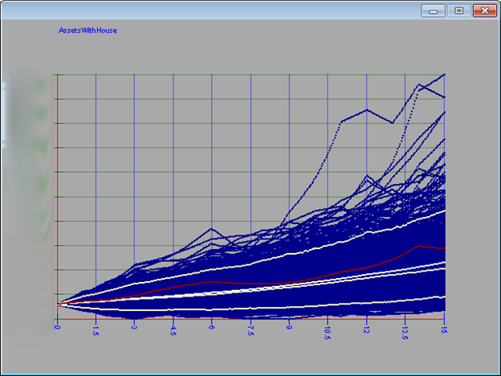
E.g.: Total Assets With House vs. time
Blue are individual outcomes in each of the “worlds”
White is the average
Yellow is top 95%, median, and bottom 5%
Red is one random outcome highlighted
Notes:
Yellow are top 95% “most optimistic” and bottom 5% of “most pessimistic” scenarios. Middle yellow line is median, white is average. Blue are actual realizations.

Slide 23
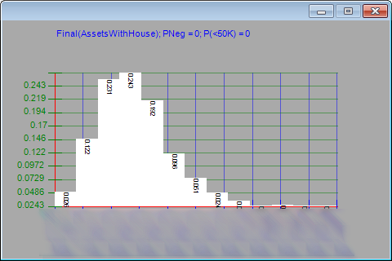
End Game Funds Distributions

Slide 24
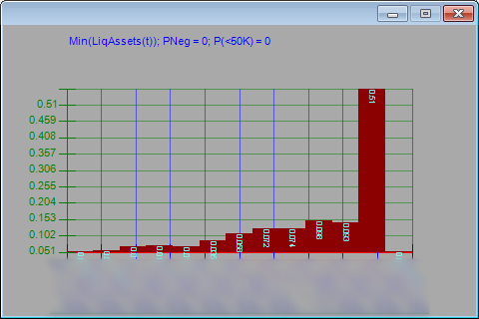
Minimum of liquid assets at any time distribution

Slide 25
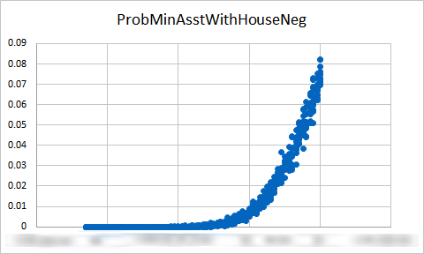
Probability of Negative Minimum Assets at any time vs. House Price (≈ prob of insolvency)
This defines our upper buying price

Slide 26
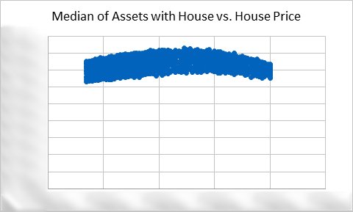
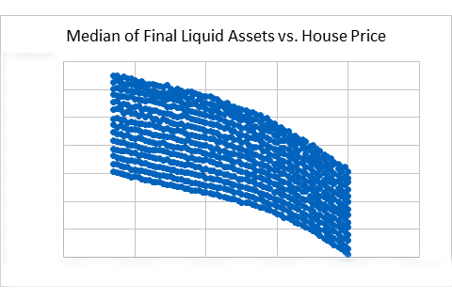
End Game Distributions

Slide 27
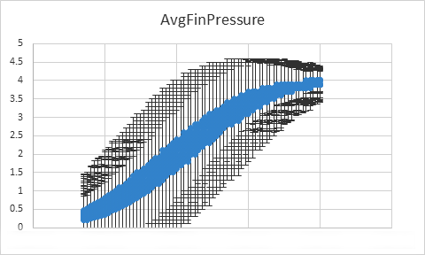
Enjoyment of Life vs. House Price?
Financial pressure: a variable reflecting the degree of forced economy.
0 – no at all, buy just everything you normally want
1 – minor (≈ postpone some luxury)
4 – extreme control of even the most basic food and clothing

Slide 28
Conclusions
For our financial profile and life goals and …
For current local market conditions…
Buying is more profitable than renting
But marginally
The difference is 10% of total assets value over the observation period
Most difference is simply from higher financial pressure (lots of house profitability comes from implicit forced saving)
…if financial pressure is fixed, the delta is ~ 5% of the final end game figure
Generally, if you have free money, you’d better invest them into stocks rather than a house. Buy a home only if you need it for living.
Local conditions are a strong game changer
MSFT, Alibaba, Google, Amazon, Boeing ↑↑
Злые гопники, bad neighbors, road slide, toxic waters ↓↓

Slide 29
The End

Slide 30
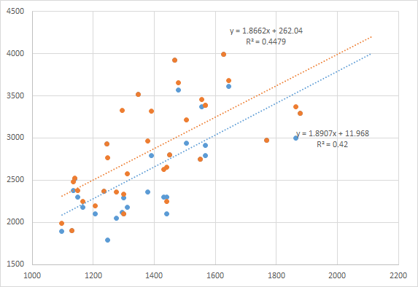
Appendix 1. Rent price vs. sq. footage, 3 BDRM, East Side, Nov-Dec 2016

Slide 31
Why House ≠ Investment?
Long term appreciation ≈ inflation
Minus interest you pay to the bank
Minus maintenance cost that is comparable to property cost over ~30 years
Minus insurance, taxes, and your time
Even an appreciated house ≠ money
Transaction is slow (weeks vs. minutes for stocks)
Transaction costs are high (~a few $K)
You cannot sell it by parts (contrary to stocks)
Though yes, you can rent it out – during good markets
Very sensitive to local conditions
Bad neighbors, closed factory, toxic waste dump can de-evaluate your property by a great margin

Slide 32
Is the Land Really Limited? No!
Land area on Earth is 148 million km². Around 35% of that is used for crops growing – that makes 96 mil km². Assume only 10% of that is good for living (so the rest are arctic, deserts, mountains, or protected parks). That’s 9.6 mil km². Divide by 7 billion people on Earth. That is 1371 m², or 14,700 sq. ft. per person, including infants – and assuming all buildings are 1-floor.
For the USA (9.8 million km², 320 million people) that is 1966 m² per person.
Japan is a good example of a developed country with much higher population density (336 people per km², or ~200 m² per person under the same assumption of ~6% of the land being good for living), yet its’ real estate price was *declining* for the past 25 years.
That suggest not the shortness of *land*, but shortness of *developed* land (with roads, electricity, water, jobs around) is what drives prices up. But that limit is not physical. Rather, just business ☺

Slide 33
Correlations?
To compute cash flow, we sum N parameters Σa_{i}, where a_{i} are drawn independently as uncorrelated.
But in reality they are! Doesn’t that invalidate the result?
My best guess: not significantly
Intuition: if N is sufficiently large, most correlations cancel each other out. Ignoring them increases the noise of the result, which is dealt with by increased number of simulations T. Of course, it requires accounting for the top few most significant (if known) correlations explicitly. But the more various parameters your throw in, the better the result is.
Kind-a sort-a semi-proof idea below:
In each world, in each time slice Cash = Σ_{N}aI_{n} + ½*Σ_{i≠j}aI_{i} * C_{ij}, where C_{ij} = Corr(a_{i}, a_{j}) and aI_{i} – independent part of a_{i}
Problem: for N variables, there are N*(N-1)/2 of C_{ij} – and most will never be known. We simply can’t compute them all.
Approach: ignore the 2nd term, except maybe 1-3 well-known C_{ij}, introducing an error E = ½*Σ_{i≠j}aI_{i} * C_{ij}
Simplification: approximate C_{ij} as a diagonal + a random value: C_{ij} ≈ δ_{ij} + ε_{ij}, where ε_{ij} is zero mean across the matrix
Zero mean is an explicit expression of the fact that we know nothing about correlations thus having no reason to prefer either positive or negative mean
This is not my idea. Strong force operator matrix within nuclei is sometimes modeled in a similar manner.
Also observe that if you tend N -> ∞, the sum aI_{k} + Σ_{k≠j}aI_{i} * C_{kj} remains bound (while the weather on Mars changes strongly, the house price impact of it is nothing). That suggests that |C_{kj}|-> 0 rather fast as j increases (for a fixed k), meaning real life systems are mostly weakly correlated for sufficiently large N, further supporting the simplification of C_{ij} ≈ δ_{ij} and <C_{i≠j}> = 0 and sum squares of C_{ij} being finite.
Then, the average error per time slice is <E> = (1/2N)*Σ_{i≠j}aI_{i} * C_{ij} = (1/2N)*Σ_{iI}a_{i}Σ_{j}C_{ij} = (1/2N)*Σ_{iI}a_{i}*<C_{ij}> ≈ 0
In other words, the means don’t change (well, in fact there is some constant bias – but hope is it is relatively small)
Of course, the average squared error increases since Q = sum squares of C_{ij} is > 0.
We deal with it by increasing the number of simulations T.

